Slide 1
Preparation of Team charter
How to create a high-performance team

Slide 2
What is a team charter?
A team charter is the set of principles that the team wants to live by.
It must be prepared by the team
It is owned by the team and must be visible to the team and all those who work with the team.
It defines who we are and how we like to work.
example

Slide 3
Why a team charter?
Most teams want to do a good job.
After all, it is unpleasant to feel that you have not done the best when you could have done better.
And as people, we naturally want to feel good and be proud of what we deliver, put a little differently:
We are a group of great people who want to deliver value.
My job as scrum master is to help you on your way.

Slide 4
How do we prepare a team charter
A charter must be simple, important and must be drafted because:
  These are the 'rules of the game'
  Helps us have a team culture of safety and confidence
  Controls our expectations of others
  May include practical things
  Is short and simple so we can remember it
  It needs to be on the wall for everyone to see
Notes:
It was important to first set the scene and explain to the team what a charter is and why it is a good idea to have one.

Slide 5

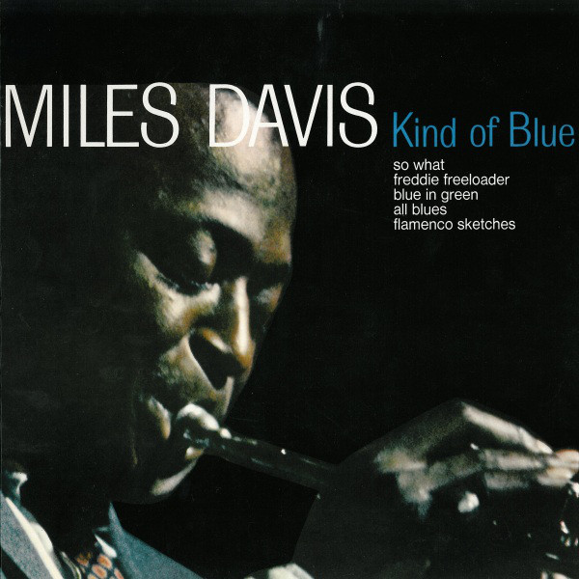
A story about:
Simplicity
New frames
Few rules
improvisation
and a special team of individualists
Notes:
Icebreaker
Read: http://www.grainger.dk/2022/01/10/scrum-and-all-that-jazz/

Slide 6
How will a worst team behave in relation to:
Colleagues in the team – the team as a whole
Processes and communication
Delivery of new functions
Use of technology
Guest players and other Stakeholders
The result is presented in plenary
Notes:
If there are many examples of bad behavior, the individual groups must vote on them and find the three most important.
All teams explain their observations in plenary.
This is where backward thinking comes into play - the teams were now encouraged to take their ideas (and anything they had updated as a result of what they had heard from other teams) and instead note down the characteristics of successful teams.
We encouraged them to think about their own context and the overall team, and how they wanted to collaborate and be recognized by stakeholders and other teams.
Once the teams have flipped their ideas, we bring the ideas from each group together. A plenary discussion enables us to find common ground, discuss each theme and agree on its importance.
The result is a number of themes, one per Post-it note, on the board. There were many ideas.
Finally, it is the team's turn to agree on what the most important things were to them. This would be the one that ended up on the charter. So, another dot vote was called for. Each team member dot voted on their top 7 characteristics of our team.

